Slide 1
CONSTRAINTS -III

Slide 2
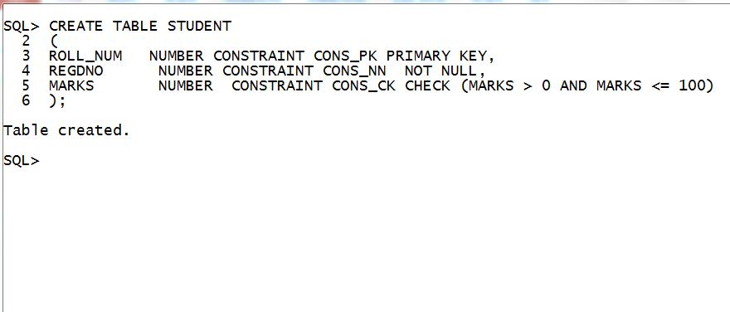

Slide 3
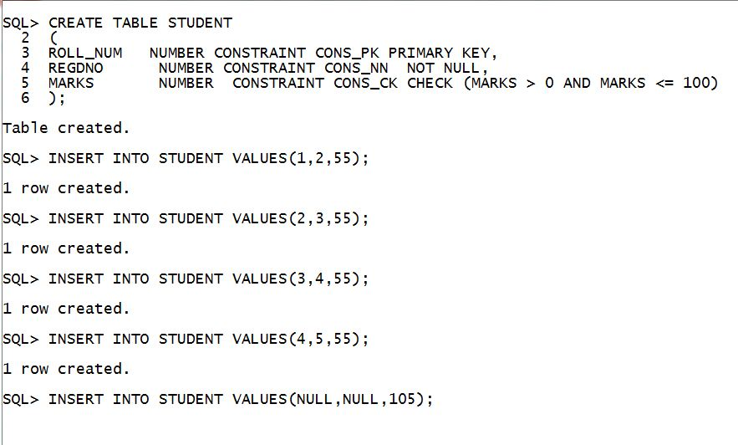

Slide 4
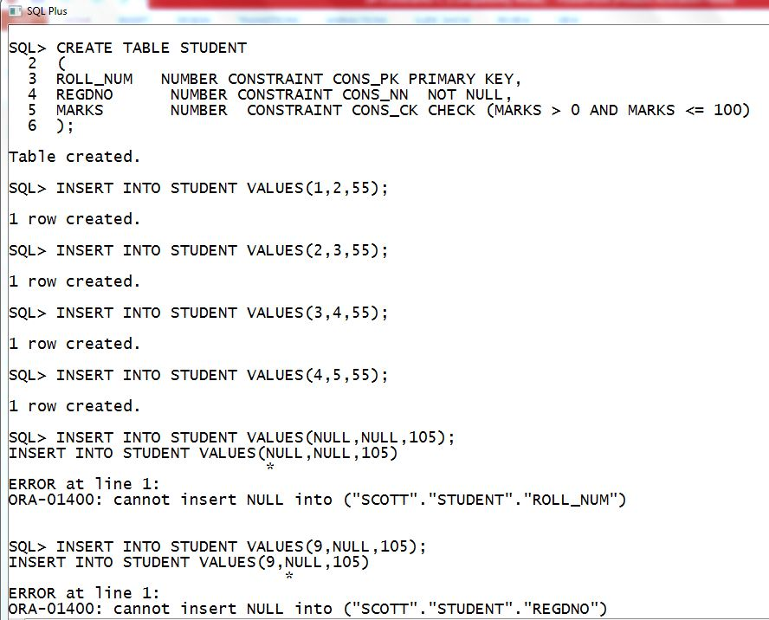

Slide 5
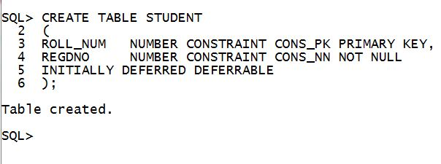

Slide 6
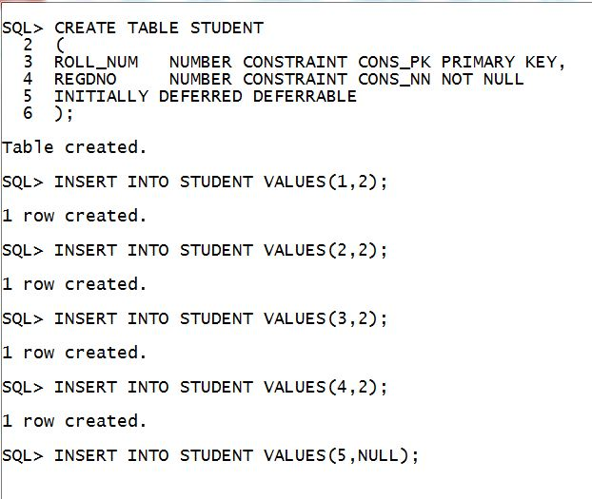

Slide 7
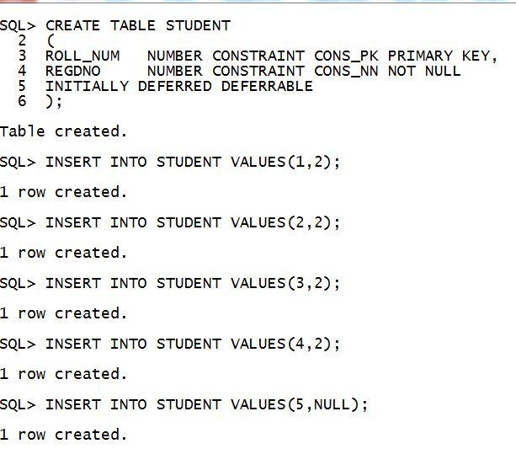

Slide 8
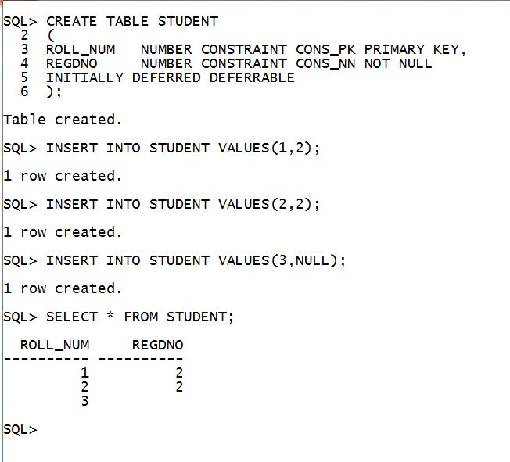

Slide 9
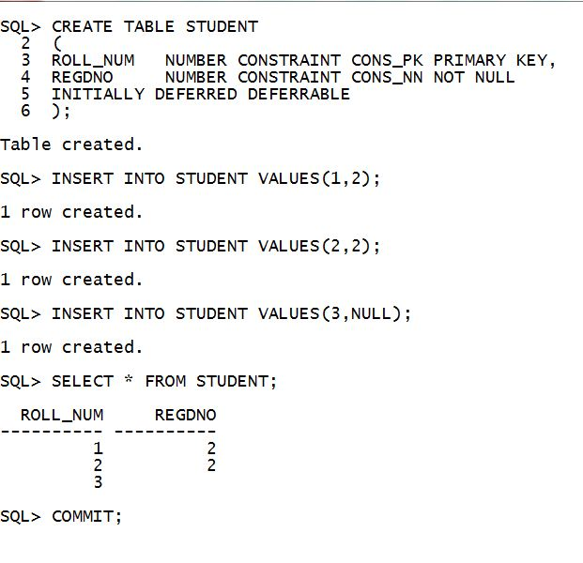

Slide 10
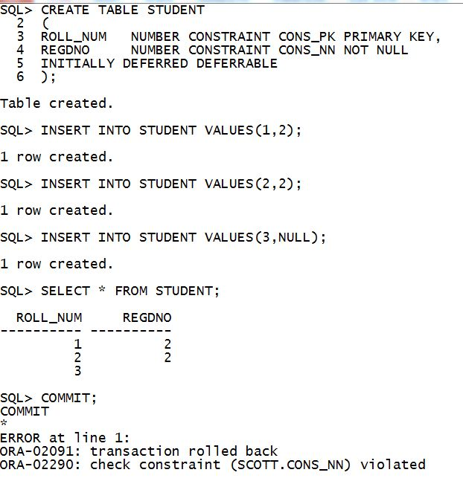

Slide 11
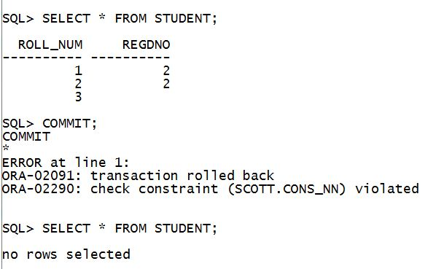

Slide 12
Constraint checking can be done in two ways
When the statement ends
OR
When the transaction commits

Slide 13
DEFERRABLE | NOT DEFERRABLE
Specifies whether the constraint checking can be delayed till transaction commit or not
Specify DEFERRABLE to indicate that constraint checking can be done at end of DML statement and can be delayed until the end of the transaction.(Checking can be done in both ways).
Specify NOT DEFERRABLE to indicate that this constraint is checked at the end of each DML statement only and the checking cannot be delayed till end of transaction.(Checking can be done in one way only).

Slide 14
Constraint checking can be done in two ways
At Statement End
OR
At Transaction commit
When should it do???
specify INITIALLY clause to indicate when the constraint should do the checking

Slide 15
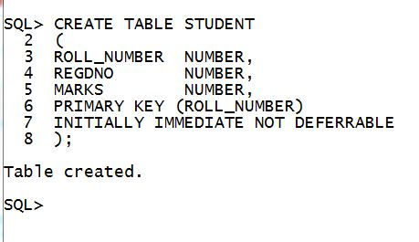

Slide 16
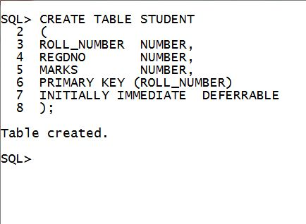

Slide 17
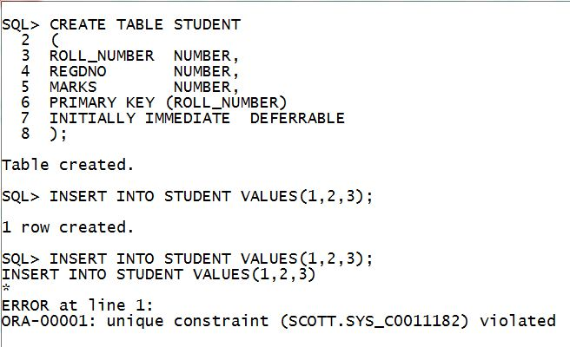

Slide 18
ALTER TABLE orders modify constraint
unq_num deferrable ;
  You cannot specify either DEFERRABLE or
  NOT DEFERRABLE if you are modifying an existing constraint by specifying the ALTER TABLE ... MODIFY constraint statement.

Slide 19
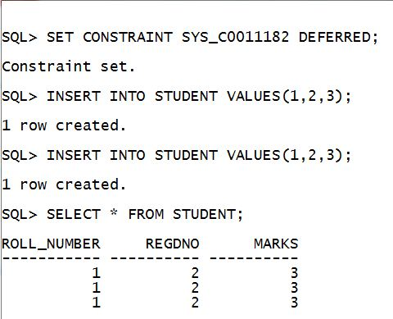

Slide 20
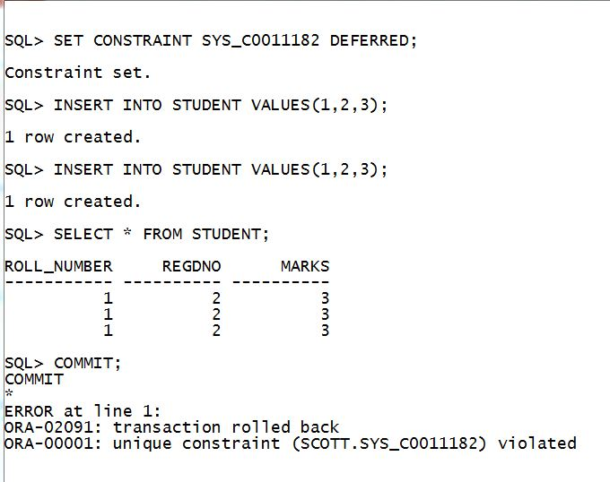

Slide 21
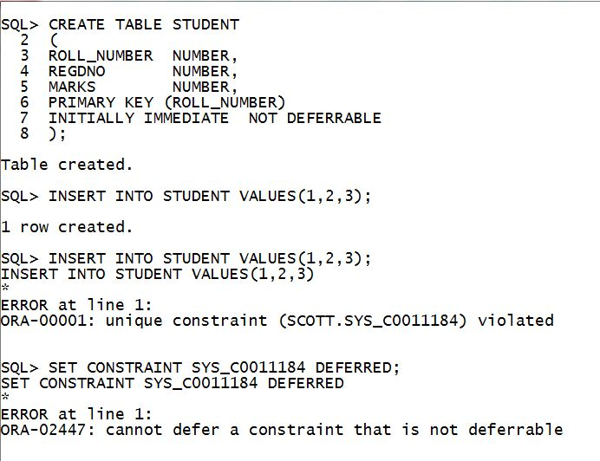

Slide 22
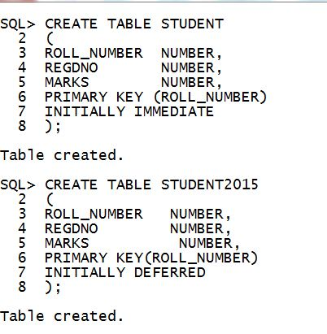

Slide 23
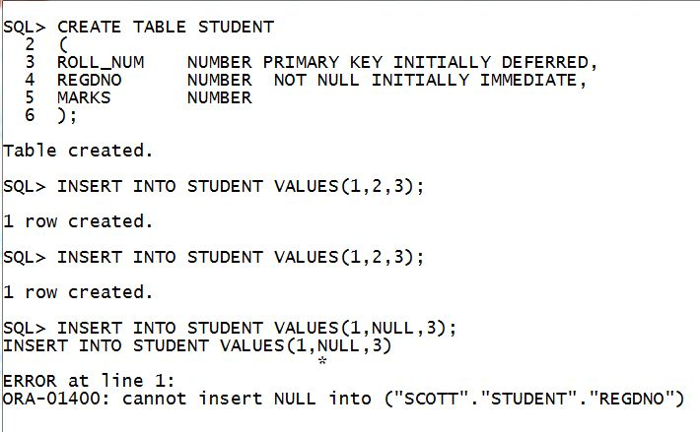

Slide 24
ALTER SESSION SET CONSTRAINTS=DEFERRED;
OR
SET CONSTRAINTS ALL DEFERRED;
Use the above statements to delay the constraint checking for all deferrable constraints till end of transaction or commit point

Slide 25
ALTER SESSION SET CONSTRAINTS=IMMEDIATE;
OR
SET CONSTRAINTS ALL IMMEDIATE;
Use the above statements to do the constraint checking for all constraints at end of statement.

Slide 26
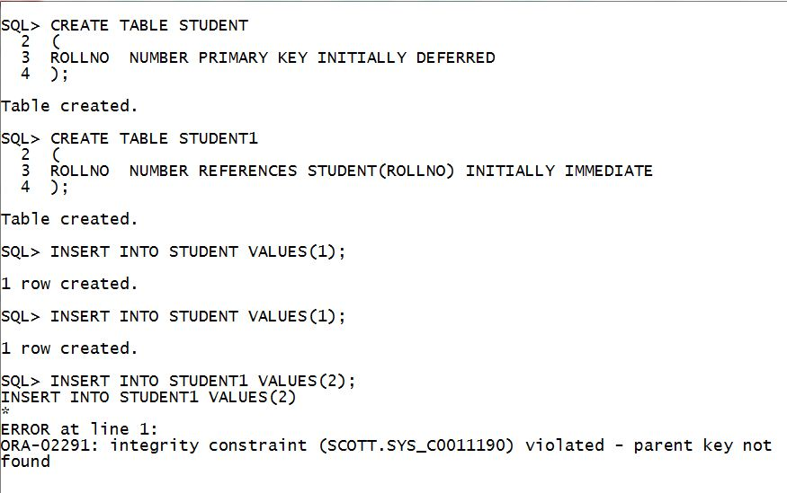

Slide 27
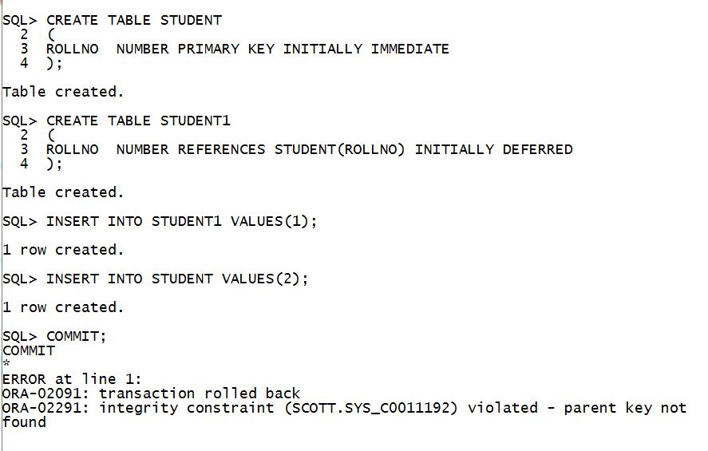

Slide 28
Enabling and Disabling Constraints
ENABLE and DISABLE clause affect only future data that will be added or modified in the table.
VALIDATE AND NOVALIDATE keywords in the ALTER TABLE statement act on the existing data.

Slide 29
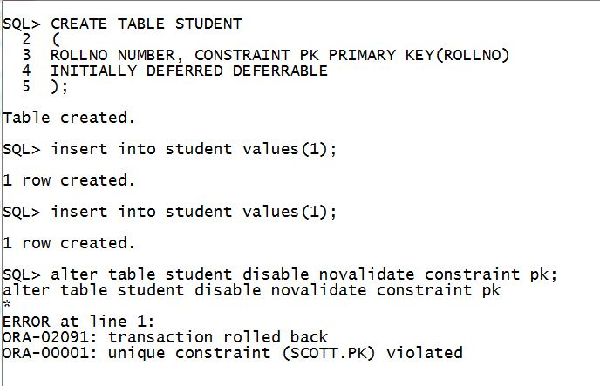

Slide 30
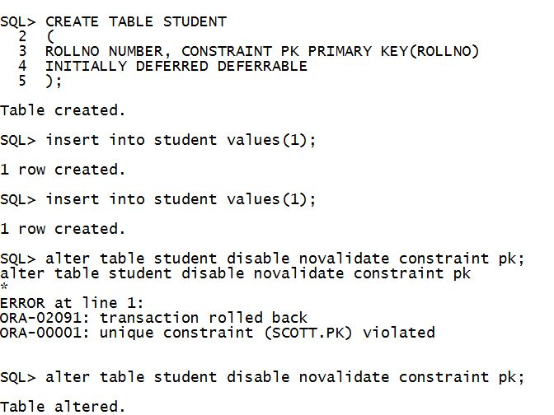

Slide 31
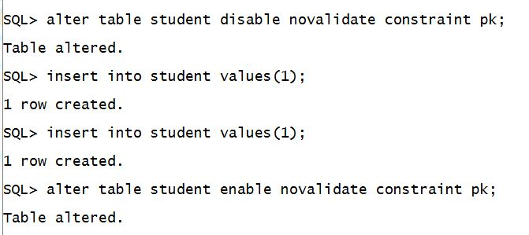

Slide 32
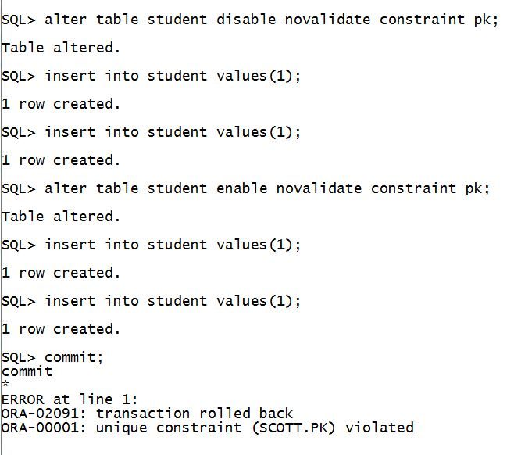

Slide 33
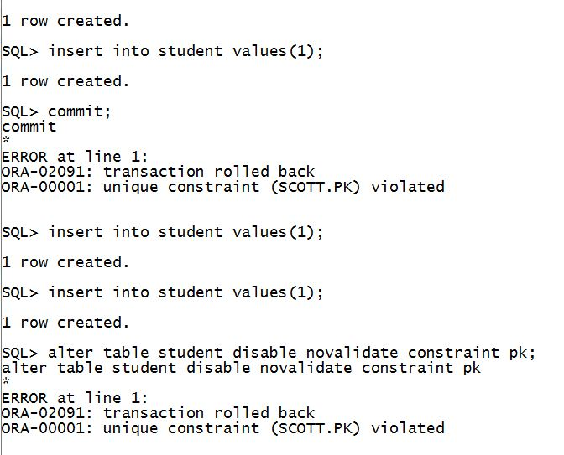

Slide 34
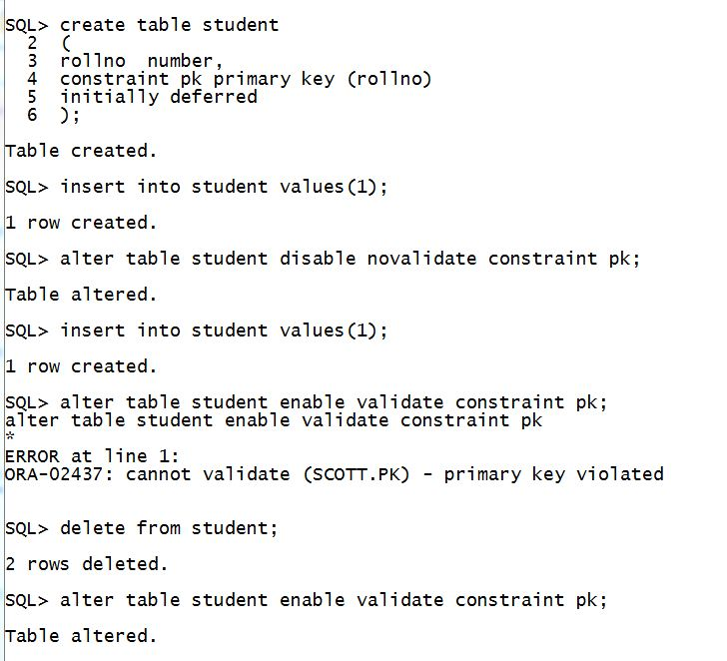

Slide 35
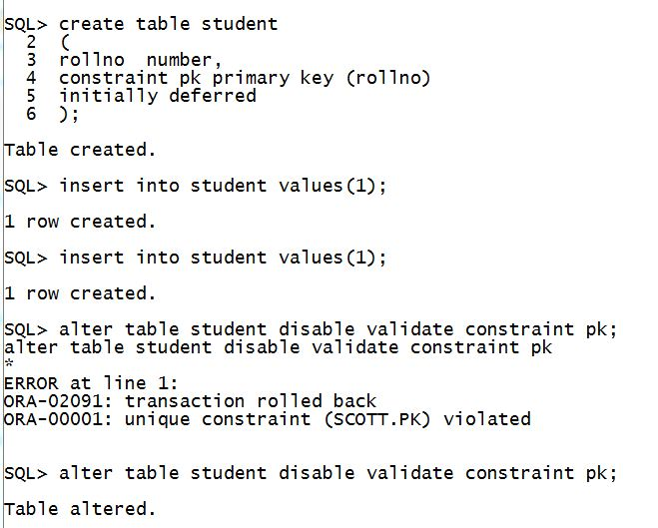

Slide 36
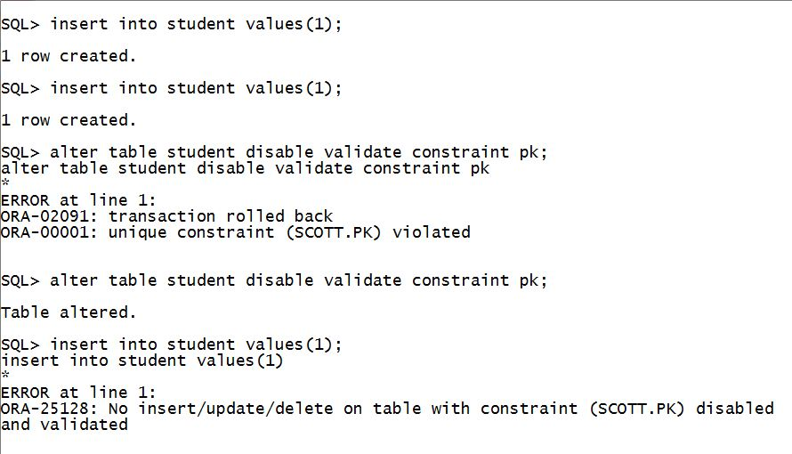

Slide 37
ALTER TABLE <TABLE_NAME> MODIFY CONSTRAINT <CONSTRAINT_NAME> ENABLE VALIDATE ;
ALTER TABLE <TABLE_NAME> MODIFY CONSTRAINT <CONSTRAINT_NAME> ENABLE NOVALIDATE;
ALTER TABLE <TABLE_NAME> MODIFY CONSTRAINT <CONSTRAINT_NAME> DISABLE VALIDATE;
ALTER TABLE <TABLE_NAME> MODIFY CONSTRAINT <CONSTRAINT_NAME> DISBALE NOVALIDATE;

Slide 38
NISTIAN
RegnNum | Varchar2(12) | PK
Name | Varchar2(80)
DOB | Date
Address | Varchar2(100)
BranchCode | Varchar2(5) | FK
BRANCHES
BranchCode | Varchar2(5) | PK
BranchName | Varchar2(50)
SQL> Alter table NISTIAN disable primary key;
alter table nistian disable primary key
*
ERROR at line 1:
ORA-02297: cannot disable constraint (SCOTT.SYS_C009545) - dependencies exist

Slide 39
You cannot disable a primary key or unique key if foreign keys that are enable reference it.

Slide 40
NISTIAN
RegnNum | Varchar2(12) | PK
Name | Varchar2(80)
DOB | Date
Address | Varchar2(100)
BranchCode | Varchar2(5) | FK
BRANCHES
BranchCode | Varchar2(5) | PK
BranchName | Varchar2(50)
SQL> Alter table Branches disable constraint BranchCode_FK;
SQL> Drop Table Nistian;
*
ERROR at line 1:
ORA-02449: unique/primary keys in table referenced by foreign keys

Slide 41
You cannot drop a table whose primary key is being referenced by a foreign key even if the foreign key constraint is in DISABLE state.

Slide 42
To disable all the referenced foreign keys and the primary or unique key, specify CASCADE.
ALTER TABLE ORDERS DISABLE PRIMARY KEY CASCADE;
Enabling primary key constraint later will not enable the foreign key.

Slide 43
CREATE TABLE ORDERS
(ORDER_ID NUMBER CONSTRAINT ORDER_ID_PK PRIMARY KEY,ORDER_DATE DATE);
ENABLE / DISABLE :
ENABLE
VALIDATE / NOVALIDATE :
VALIDATE
INITIALLY IMMEDIATE/DEFERRED :
INITIALLY IMMEDIATE
DEFERRABLE/NOT DEFERRABLE :
NOT DEFERRABLE
CREATES CONSTRAINT ORDER_ID_PK
ENABLE VALIDATE INITIALLY IMMEDIATE NOT DEFERRABLE

Slide 44
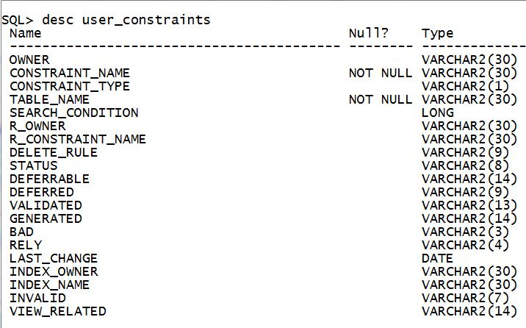

Slide 45
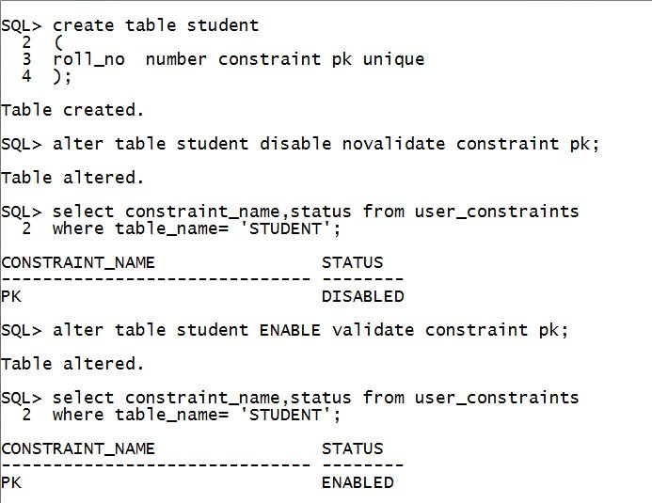

Slide 46
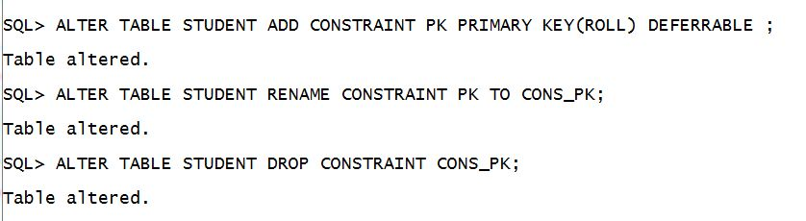

Slide 47
RELY/NORELY
Specifies whether an enabled constraint is to be enforced.
Specify RELY to enable an existing constraint without enforcement.
Specify NORELY to enable and enforce an existing constraint.
The default is NORELY.

